Slide 1



Slide 2

How AI is Turning SEO on Its Head
The Evolution, Impact, and Future of AI in SEO

Slide 3


Spoiler Alert:
SEO isn’t dead & AI isn’t killing SEO—it’s changing the rule

Slide 4
Al Sefati
CEO & Founder of Clarity Digital Agency

Slide 5

Al Sefati
About Me
CEO of Clarity Digital Agency (www.ClarityDigital.Agency)
Focus on eCommerce (over half of our clients are eComemrce brands)
B.S. in Computer Science (2002)
Tech industry since 1999
Web Developer Turned SEO Expert
Transitioned to holistic SEO & SEM mastering al aspect of search marketing
Running my agency has evolved me into an omni-channel marketer

Slide 6
SEO Evolution
Google Taking Over with Major Updates
(2000s-2010s)
Emergence of Accidental Search Engines
Early SEO
(Late 90s-2000s)
Multiple search engines (yahoo, Excite, Altavista, MSN, Ask, AOL, Dogspile)
Keywords Stuff
Google PageRank
Exchange & Backlinks
Exact match Domain
Black & Gray Hat & SEO
Panda
Penguin
Hummingbird & Semantic
Rank Brain
BERT (NLP) Update
EEAT Framework
Google Core Updates
Emergences of accidental search engines (Amazon, Social Search,Youtube)
Google Monopoly challenge

Slide 7
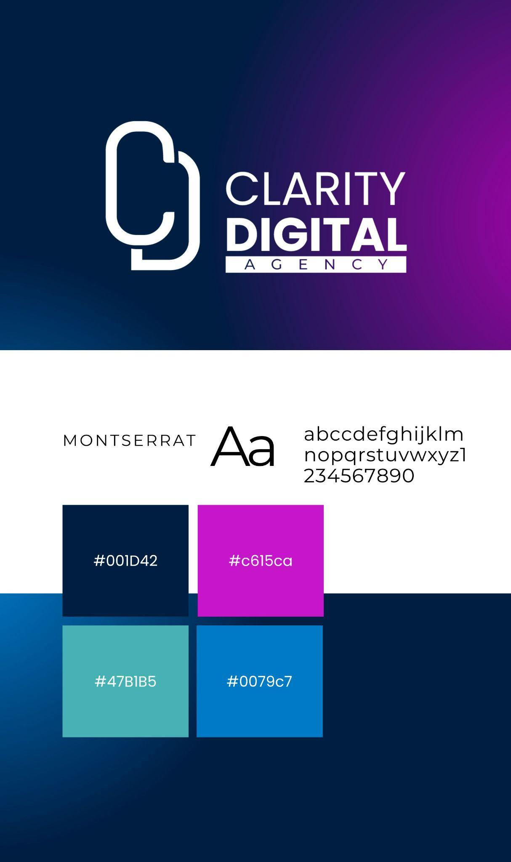
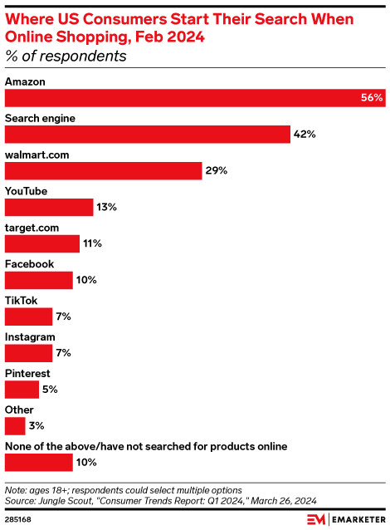
Accidental Search Engines
E-Commerce Sites & Social Media
Amazon because the largest product search.
Walmart and Target also became a noticeable product search engines.
Social media sites became search engines
  Facebook & Tiktok for products
  Instagram, Pinterest, Youtube and others for research

Slide 8

Enter Gen AI Search

Slide 9
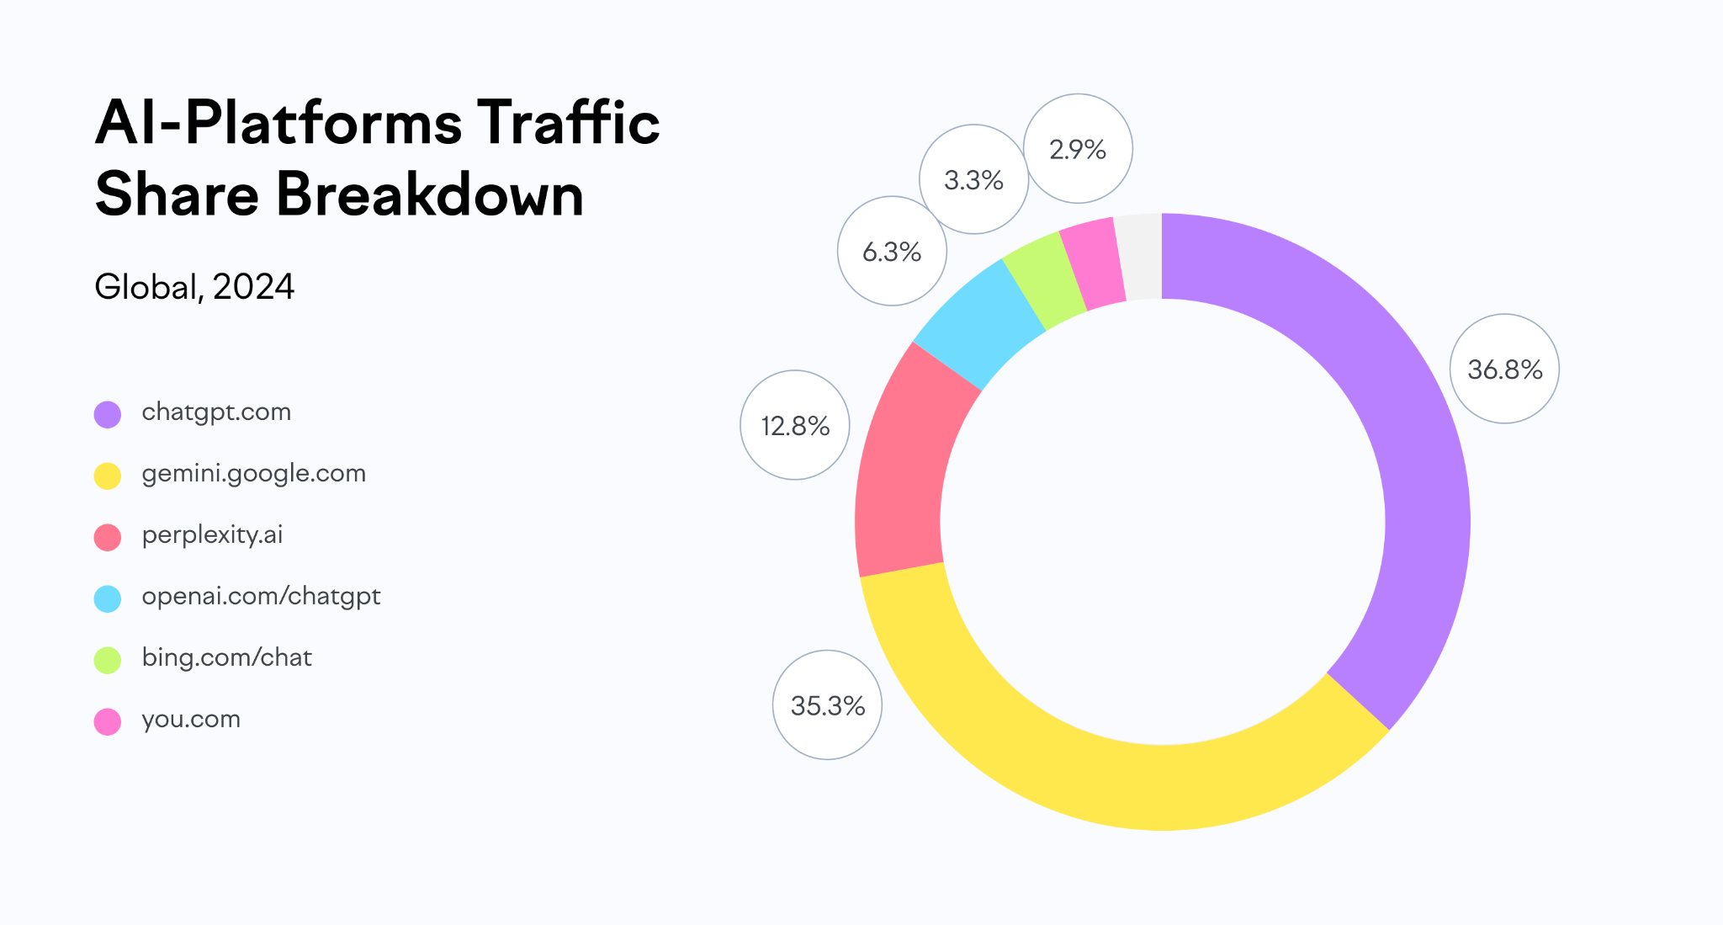
AI Search
Generative AI
Generative AI Search is redefining how user seek and find information
Source: Semrush

Slide 10
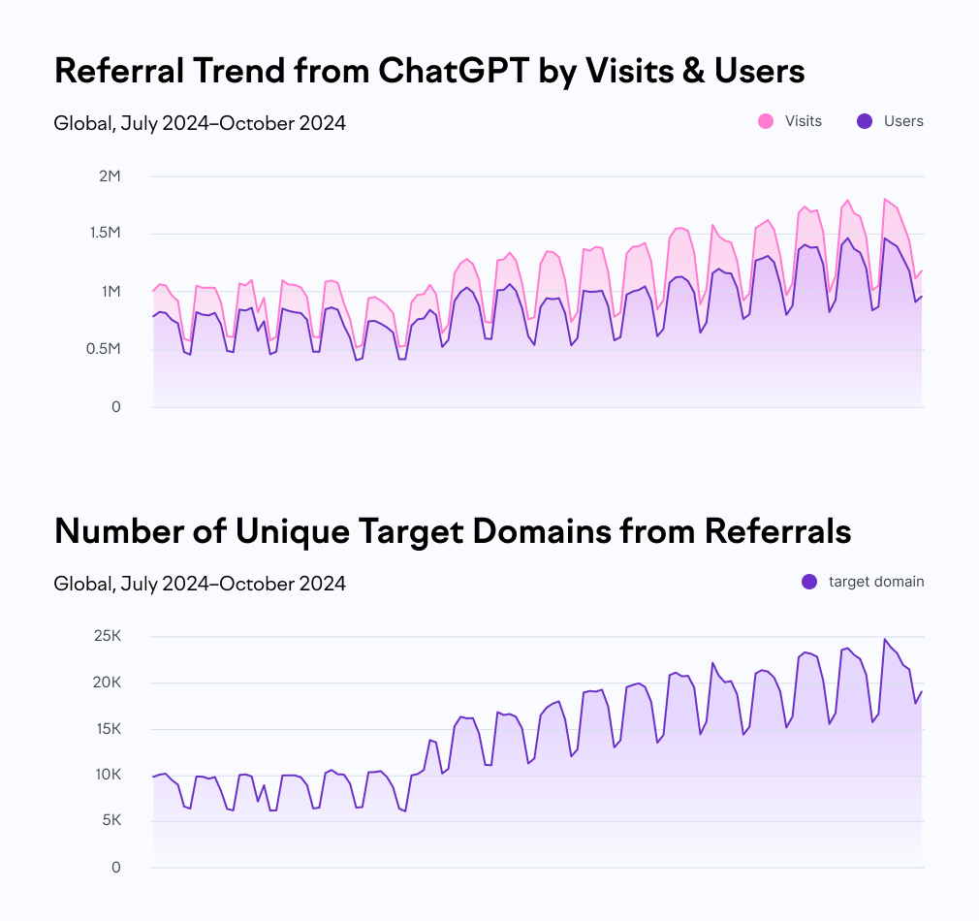
AI Search
ChatGPT Referral Traffic
Semrush .Trends data shows redirects from ChatGPT to other domains rose by 60% between June and October, with unique target domains increasing from just over 10,000 to nearly 25,000.
Source: Semrush

Slide 11
How To Optimize for AI
Focus on 4 Cs Principles of SEO They are Still Valid
Code
Content
Credibility
Customer Experience

Slide 12

AI Search
Search Preferences & Generational Shift
Code
Content
Clean, fast, and structured code ensures search engines can crawl and index efficiently.
High-quality, relevant and unique content drives engagement and visibility.
Credibility
Customer Experience
A strong digital footprint—brand mentions, citations, positive sentiment, and quality backlinks—builds trust and authority.
A seamless user experience keeps visitors engaged and converts them into satisfied customers.

Slide 13





Other Optimization Factors
According to ChatGPT
Conversational & Natural Language Optimization
APIs & AI indexing
AI Generated Summaries
Multiple Formats & Channel Content Marketing
Personalization

Slide 14
SEO Before & After AI
Before AI
After AI
Keywords-Based SEO
Google-Centric
Manual Content Creation
Backlink-Focused Authority
SERP Ranking Mattered Most
Static Algorithm
Website-Centric SEO
Manual SEO audits & Implementation
Generic User Experience(UX)
SEO KPI: Rankings & Traffic
Contex, Intent & Entity SEO
Multiple-platforms & Omni-channel SEO
AI assisted content & Optimization
Expand digital footprint (not just links but mentions, citations, reviews and sentiment)
AI-generated answers & Zero-click search
Real-Time AI Powered Audits & Implementations
AI-personalized search experience
Define new KPIs (AI visibility & influence)

Slide 15

Future of SEO Role

Slide 16
“
SEOs & Marketers Must Evolve

Slide 17
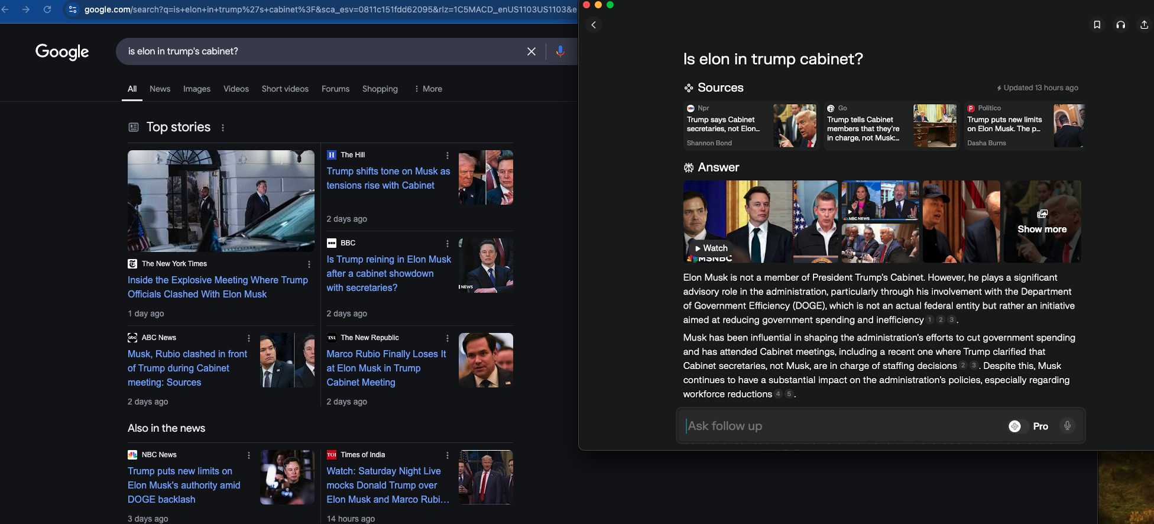
SEOs Must Strategize for AI
AI search popularity is rising
On informationational searches, AI searches can provide better search results
  Example: Take a look at this comparison—Perplexity AI vs. Google. The difference is night and day. I asked the same question: "Is Elon in Trump's Cabinet?"

Slide 18
Consider AI SEO First
Traditional search engines like Google are becoming less relevant for informational searches. Take a look at this comparison—Perplexity AI vs. Google. The difference is night and day.
I asked the same question: "Is Elon in Trump's Cabinet?"
Google: A list of links to sift through.
Perplexity AI: A direct answer, backed by
sources for deeper reading.
AI-driven search is changing user behavior and your SEO strategy must keep up.

Slide 19

What AI Can’t Do (Yet)
Search Preferences & Generational Shift
Strategic SEO Planning
Understanding Complexities
AI can not know your business goals or brand positioning.
AI can generate content but human expertise must guide it. AI struggles with contextual depth, industry nuances, and strategic adaptability in SEO
Building Relationships
Ethical & Brand Compliance
AI does do PR, partnerships, or thought leadership.
AI can hallucinate, plagiarize or be inconsistent. Human intervention and guidance needed.
Creativeness
Competitive & Market Insights
AI can provide powerful tools to be creative but humans must lead creative efforts.
AI can analyze data but humans must ask the question and turn AI generated insights to make key decisions

Slide 20
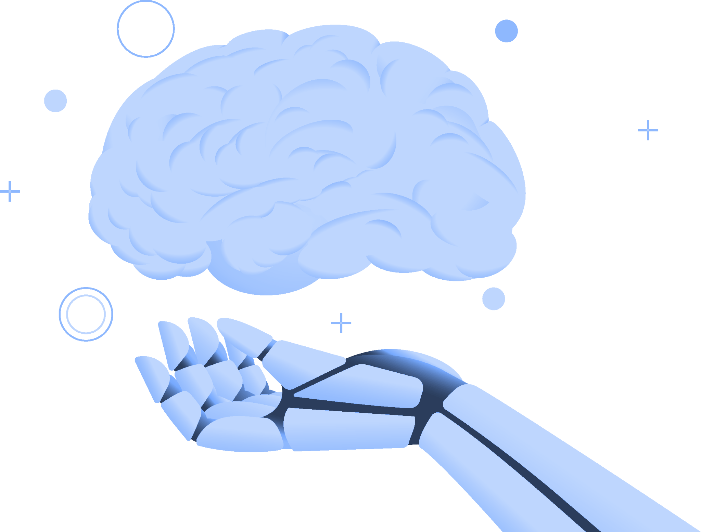
Final Thoughts
AI is transforming SEO, not eliminating it
Search disruptions are inevitable
Traditional SEO methods will become obsolete
New approach to SEO (AI SEO and multi-channel) will be essential for success
SEOs & Marketers must shift toward strategic approach leveraging AI for automation and gain deeper insights

Slide 21
Thank You.
Don’t be a stranger, shoot me an email and let me know if you have any questions. My email and website URL below:
Email: al@ClarityDigital.Agency
Website: ClarityDigitalAgency

